Slide 1

Apache Hive
Data warehouse software facilitates reading, writing, and managing large datasets residing in distributed storage and queried using SQL syntax.

Slide 2
Hive Features ?
Hive is build at the top of Map Reduce and provides below features
Tools to enable easy access to data via SQL, thus enabling data warehousing tasks such as extract/transform/load (ETL), reporting, and data analysis.
A mechanism to impose structure on a variety of data formats
Query execution via various executions engines like Tez, Spark and Map Reduce
Provides standard SQL functionality, including many of the later SQL:2003 and SQL:2011 features for analytics.
There is no specific Hive format that data must be stored, but various connectors to read and write Text, CSV data. More connectors can be added !

Slide 3
What Hive Can do ?
Hive Data Definition Language
CREATE/ DROP /ALTER / USE Database
CREATE/ DROP/Truncate Table
ALTER Table/Partition/Column
CREATE/ALTER/DROP View
CREATE/ALTER/DROP Index
CREATE/DROP/GRANT/REVOKE Roles and Privileges
Hive Data Manipulation Language
LOAD, INSERT, UPDATE, DELETE
Data Retrieval
SELECT, WHERE, SORT
GROUP BY
JOINS
UNIONS
SUB QUERIES
EXPLAIN
File Formats
Avro File Format
ORC File Format
Parquet
LZO Compression

Slide 4
What HIVE is not ?
Hive is not a RDBMS !
Hive is not designed for online transaction processing (OLTP) workloads.
It is best used for traditional data warehousing tasks.
Correlated subqueries
Even with small amount of data time to return the response can’t be compared to RDBMs

Slide 5
Connecting to HIVE
Hive shell
JDBC Driver
ODBC Driver
Thrift Client

Slide 6
Hive Architecture
Local Mode
CLI shell
Hive Driver
Compiler
Executor
Meta Store
Meta Store
DB
Hadoop
HDFS

Slide 7
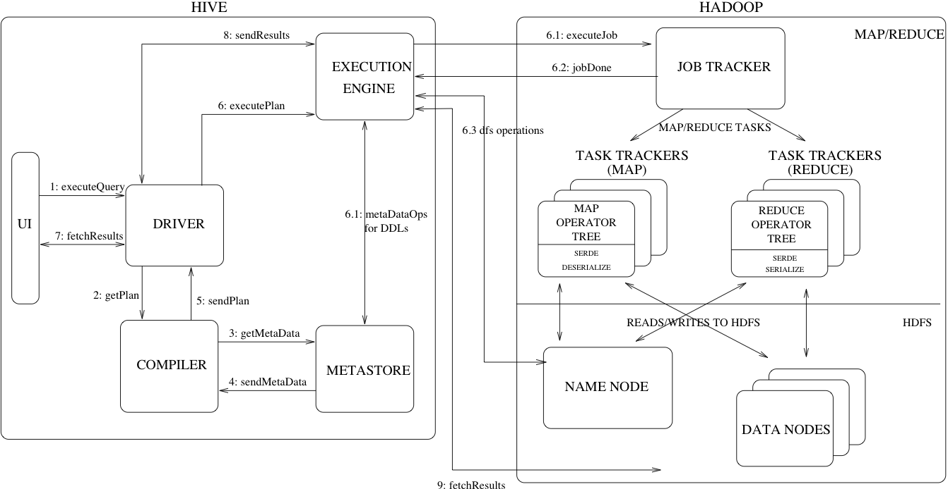

Slide 8
Hive Components
HCatalog - is a component of Hive. It is a table and storage management layer for Hadoop that enables users with different data processing tools — including Pig and MapReduce — to more easily read and write data on the grid.
WebHCat - provides a service that you can use to run Hadoop MapReduce (or YARN), Pig, Hive jobs or perform Hive metadata operations using an HTTP (REST style) interface

Slide 9
Hive MetaStore
Persists Schema, i.e. table definition(table name, columns, types)
Location of table files
Row format of table files
Storage format of files
Exercise
Check Hive configuration to know DB instance [MySQL in this case] and of the meta-store DB in
Log in to MySQL Instance on your cluster and look for Hive meta-store DB.

Slide 10
Lets do Hive !
We are going to use data of truck driver statistics for some simple computing using Hive.
Use ‘driver_dataset’ provided for this session
drivers.csv is comma separated file with fields as driverId, name, ssn, location, certified, wage-plan
Timesheet.csv is comma separated file with fields as driverId, week, hours-logged, miles-logged
Truck_events_partition.csv is comma separated file with fields as driverId, truckId, eventTime, eventType, longitude, latitude, eventKey, CorrelationId, driverName, routeId, routeName, eventDate

Slide 11
Create and use a new database in hive
CREATE DATABASE IF NOT EXISTS MYDB;
USE MYDB;
2 Create a managed table stored as Text File use a new database in hive
CREATE TABLE MYDB.drivers (
driverId INT,
name STRING,
ssn BIGINT,
location STRING,
certified STRING,
wageplan STRING
)
ROW FORMAT DELIMITED
FIELDS TERMINATED BY ','
STORED AS TEXTFILE;
Note: verify directory structure changes in Hive warehouse in HDFS to understand managed table’s location
Learn & Discuss
Default database & working with multiple databases
Managed & External Tables
ROW Format, Field Separator
File Formats

Slide 12
LOAD Data from Local and HDFS File System
Option 1: Load from Local File System
LOAD DATA LOCAL INPATH ‘{your local path to}/drivers.csv' INTO TABLE MYDB.drivers;
Option 2: Load from HDFS File System
LOAD DATA INPATH ‘{your HDFS path to}/drivers.csv' INTO TABLE MYDB.drivers;
Verify Data.
select count(*) from MYDB.drivers;
Learn & Discuss
Load data from local and HDFS file to Hive table

Slide 13
Create timesheet table and populate data. Overwrite table while loading
CREATE TABLE MYDB.timesheet (
driverId INT,
week INT,
hours_logged INT,
miles_logged INT
)
ROW FORMAT DELIMITED
FIELDS TERMINATED BY ',';
Option 1: Load from Local File System
LOAD DATA LOCAL INPATH ‘{your local path to}/timesheet.csv' OVERWRITE INTO TABLE MYDB.timesheet;
Option 2: Load from HDFS File System
LOAD DATA INPATH ‘{your HDFS path to}/timesheet.csv' OVERWRITE INTO TABLE MYDB.timesheet;
Verify table and data
describe MYDB.timesheet;
select count(*) from MYDB.timesheet;
Learn & Discuss
Overwrite table while loading data from local and HDFS file to Hive table

Slide 14
Join & Group By
Find out per driver total miles and hours driven
SELECT driverId, sum(hours_logged), sum(miles_logged) FROM MYDB.timesheet GROUP BY driverId;
Join with drivers table, to get drivers details
SELECT d.driverId, d.name, t.total_hours, t.total_miles from MYDB.drivers d
JOIN (SELECT driverId, sum(hours_logged)total_hours, sum(miles_logged)total_miles FROM MYDB.timesheet GROUP BY driverId ) t
ON (d.driverId = t.driverId);
Hive supports
Inner joins
Left outer joins
Right outer joins
Full outer joins

Slide 15
Find out per driver total miles and hours driven.
Populate Data into Table in ORC Format
Create ORC table to store result of above query.
CREATE TABLE MYDB.driver_aggregate_orc (
driver_id INT,
driver_name STRING,
total_hours INT,
total_miles INT
)
STORED AS ORC;
Populate Data
INSERT INTO MYDB.driver_aggregate_orc SELECT d.driverId, d.name, t.total_hours, t.total_miles from MYDB.drivers d
JOIN (SELECT driverId, sum(hours_logged)total_hours, sum(miles_logged)total_miles FROM MYDB.timesheet GROUP BY driverId ) t
ON (d.driverId = t.driverId);
Learn
Create table with ORC format and load data
ORC table can not be directly loaded using LOAD

Slide 16
Create Partitioned Table for truck_events_data. Use eventDate as partition key. Table should be stored as Sequence File.
CREATE TABLE truck_events_partitioned (
driverId INT,
truckId INT,
eventTime STRING,
eventType STRING,
longitude STRING,
latitude STRING,
eventKey STRING,
correlationId STRING,
driverName STRING,
routeId STRING,
routeName STRING,
eventDate STRING
)
PARTITIONED BY(eventDateKey STRING)
ROW FORMAT DELIMITED
FIELDS TERMINATED BY ','
STORED AS SEQUENCEFILE;
Learn & Discuss
Partitioned Table
Partitioned Key name can not match with any column
Populate data in appropriate partition

Slide 17
Try some simple analysis
Who drove maximum miles ?
select * from MYDB.driver_aggregate_orc order BY total_miles DESC LIMIT 1;
Least ?
select * from MYDB.driver_aggregate_orc order BY total_miles LIMIT 1;
Learn & Discuss
Order By, Limit

Slide 18
Create External Table for truck_events_data and load data
CREATE EXTERNAL TABLE sreehari.truck_events_external (
driverId INT,
truckId INT,
eventTime STRING,
eventType STRING,
longitude STRING,
latitude STRING,
eventKey STRING,
correlationId STRING,
driverName STRING,
routeId STRING,
routeName STRING,
eventDate STRING
)
ROW FORMAT DELIMITED
FIELDS TERMINATED BY ','
STORED AS TEXTFILE
LOCATION '/user/sreehari/truck_ext';
LOAD DATA LOCAL INPATH '/home/sreehari/data/driver_data/driver_datatruck_event_text_partition.csv' INTO TABLE sreehari.truck_events_external ;
Learn & Discuss
External Table
Partitioned Key name can not match with any column
Populate data in appropriate partition

Slide 19
Load data into Partitioned table. Data should go to appropriate partitions
INSERT INTO sreehari.truck_events_partitioned PARTITION(eventDateKey) SELECT driverId, truckId, eventTime, eventType, longitude, latitude, eventKey, CorrelationId, driverName, routeId, routeName, eventDate, eventDate FROM sreehari.truck_events_external;
eventDate is 2 time
Got an Error ? Set dynamic partition to nonstrict
set hive.exec.dynamic.partition.mode=nonstrict;
Try Now again !
Verify partitons
DESCRIBE truck_events_partitioned;
SHOW PARTITIONS sreehari.truck_events_partitioned;
Learn & Discuss
Use of External Table to populate partitioned table
Load using dynamic partitioning

Slide 20
Create Index on Existing Table
INSERT INTO truck_events_partitioned PARTITION(eventDateKey) SELECT driverId, truckId, eventTime, eventType, longitude, latitude, eventKey, CorrelationId, driverName, routeId, routeName, eventDate, eventDate FROM truck_events_external;
Got an Error ? Set dynamic partition to nonstrict
set hive.exec.dynamic.partition.mode=nonstrict;
Try Now again !
Verify partitons
DESCRIBE truck_events_partitioned;
SHOW PARTITIONS truck_events_partitioned;
Learn & Discuss
Use of External Table to populate partitioned table
Load using dynamic partitioning

Slide 21
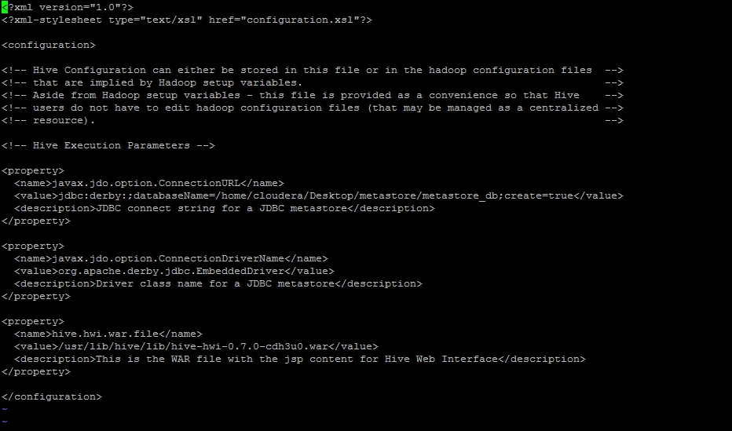
Configuring hive on vm(hive-site.xml)

Slide 22
HealthCheck
After configuring hive, type command show tables; if you get output without any error, hive is configured properly.
The logs of hive for debugging can be checked at /tmp/{username}/hive.log. If you did sudo hive with root the logs will be at /tmp/root/hive.log otherwise /tmp/cloudera/hive.log.

Slide 23
Data types
Numeric Types
TINYINT (1-byte signed integer, -128 to 127)
SMALLINT (2-byte signed integer, from -32,768 to 32,767)
INT/INTEGER (4-byte signed integer, from -2,147,483,648 to 2,147,483,647)
BIGINT (8-byte signed integer, from -9,223,372,036,854,775,808 to 9,223,372,036,854,775,807)
FLOAT (4-byte single precision floating point number)
DOUBLE (8-byte double precision floating point number)
DOUBLE PRECISION (alias for DOUBLE, only available starting with Hive 2.2.0)
DECIMAL
Date/Time Types
TIMESTAMP (Note: Only available starting with Hive 0.8.0)
DATE (Note: Only available starting with Hive 0.12.0)
INTERVAL (Note: Only available starting with Hive 1.2.0)
Misc. Types
BOOLEAN
BINARY (Note: Only available starting with Hive 0.8.0)

Slide 24
String Types
STRING
VARCHAR (Note: Only available starting with Hive 0.12.0)
CHAR (Note: Only available starting with Hive 0.13.0)
Complex Types
arrays: ARRAY<data_type>
(Note: negative values and non-constant expressions are allowed as of Hive 0.14.)
maps: MAP<primitive_type, data_type>
(Note: negative values and non-constant expressions are allowed as of Hive 0.14.)
structs: STRUCT<col_name : data_type [COMMENT col_comment], ...>
union: UNIONTYPE<data_type, data_type, ...> (Note: Only available starting with Hive 0.7.0.)

Slide 25
Syntax of collections
Create table employee (id int, name String, salary Double, skills Array<String>)
ROW FORMAT DELIMITED
FIELDS TERMINATED BY ‘\t’
COLLECTION ITEMS TERMINATED BY ‘,’
STORED AS TEXTFILE

Slide 26
External VS Managed Table
Use EXTERNAL tables when:
The data is also used outside of Hive. For example, the data files are read and processed by an existing program that doesn't lock the files.
Data needs to remain in the underlying location even after a DROP TABLE. This can apply if you are pointing multiple schemas (tables or views) at a single data set or if you are iterating through various possible schemas.
You want to use a custom location such as ASV.
Hive should not own data and control settings, dirs, etc., you have another program or process that will do those things.
You are not creating table based on existing table (AS SELECT).
Use MANAGED tables when:
The data is temporary.
You want Hive to completely manage the lifecycle of the table and data.
When external table is dropped only table is dropped i.e metadata is updated but data remains as is. If a managed table is dropped it also deletes the data.

Slide 27
Export Hive Table
INSERT OVERWRITE DIRECTORY
To write result in HDFS
LOCAL to write on local FS
Export data from Hive table to local file system
INSERT OVERWRITE LOCAL DIRECTORY ‘{path to local file}’
ROW FORMAT DELIMITED FIELDS TERMINATED BY ',' SELECT * FROM {your hive table name};
Export data from Hive table to HDFS
INSERT OVERWRITE DIRECTORY ‘{path to HDFS file}’
ROW FORMAT DELIMITED FIELDS TERMINATED BY ',' SELECT * FROM {your hive table name};

Slide 28
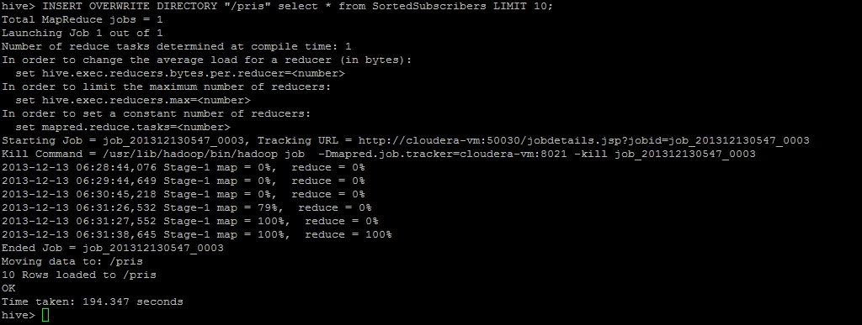

Slide 29
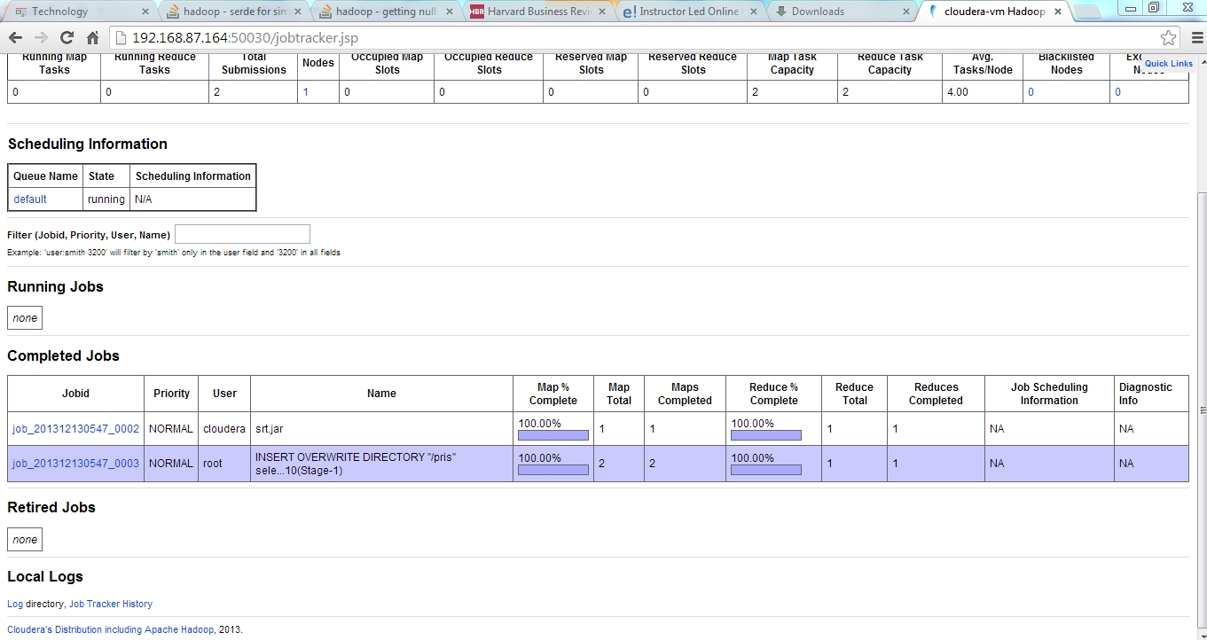
The progress of sql queries can also be checked at jobtracker page url:50030

Slide 30
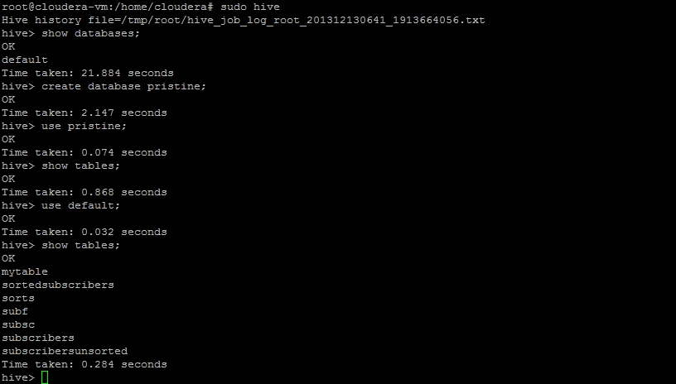
Multiple DBs in Hive
Default database is named default

Slide 31
Oder by
Select expr, expr .. from tablename
where condition
order by expr desc;
This will sort the data in descending order. The default ordering is ascending

Slide 32
Exercise
Use order by clause to sort the subscribers output generated file by hive(from MR exercise)

Slide 33
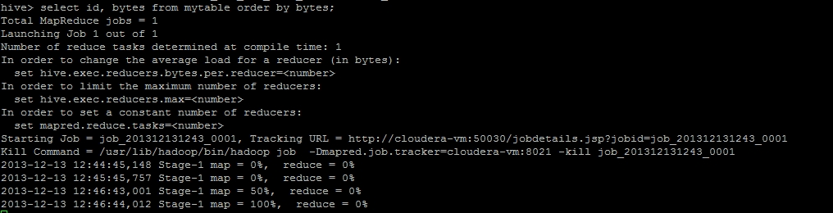
Solution

Slide 34
Sort by
SORT BY expression
Sorts the data before going to reducer
Select expr, expr … from tablename
where condition
Sort by expr

Slide 35
Comparison Sort by and order by
Sort by
May use multiple reducers for final output
Only guarantees ordering of rows within a reducer
May give partially ordered final result
Order by
Uses single reducer to guarantee total order in output
LIMIT can be used to minimize sort time

Slide 36
Joining tables
Hive supports
Inner joins
Left outer joins
Right outer joins
Full outer joins

Slide 37
Syntax
Select cols FROM table1 join table2 on [condition]

Slide 38
Join on 2 tables
Employee
EMP ID | Emp Name | Address
1 | Rose | US
2 | Fred | US
3 | Jess | In
4 | Frey | Th
Employee Department
Emp ID | Department
1 | IT
2 | IT
3 | Eng
4 | Admin

Slide 39
Inner join
Select * from employee join employee department ON(employee.empId=employeedepartment.empId)
EMP ID | Emp Name | Address | Emp ID | Department
1 | Rose | US | 1 | IT
2 | Fred | US | 2 | IT
3 | Jess | In | 3 | Eng
4 | Frey | Th | 4 | Admin

Slide 40
Left outer join
Select e.empId, empName, department from employee e Left outer join employee department ed on (e.empId=ed.empId);
EMP ID | Emp Name | Department
1 | Rose | IT
2 | Fred | IT
3 | Jess | Eng
4 | Frey | Admin
5 | Chris | null

Slide 41
Hive functions
round()
floor()
ceil()
rand()
exp()
length()
concat()
substr()
lower()
etc

Slide 42
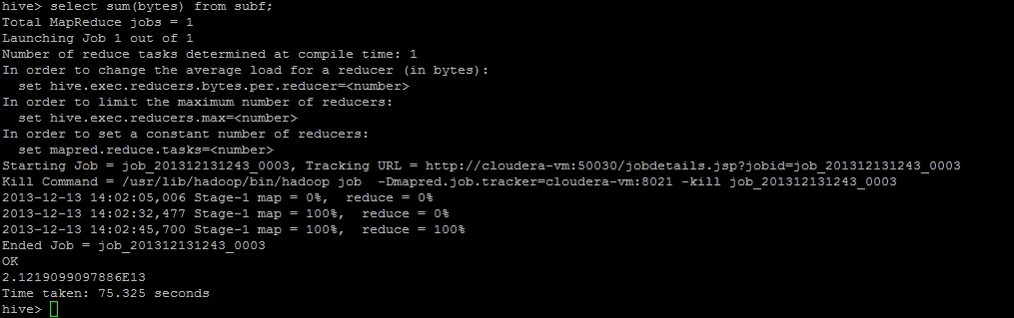
Use of functions

Slide 43
Views
CREATE VIEW view(columnNames)
As Select …
To remove view
Drop View view

Slide 44
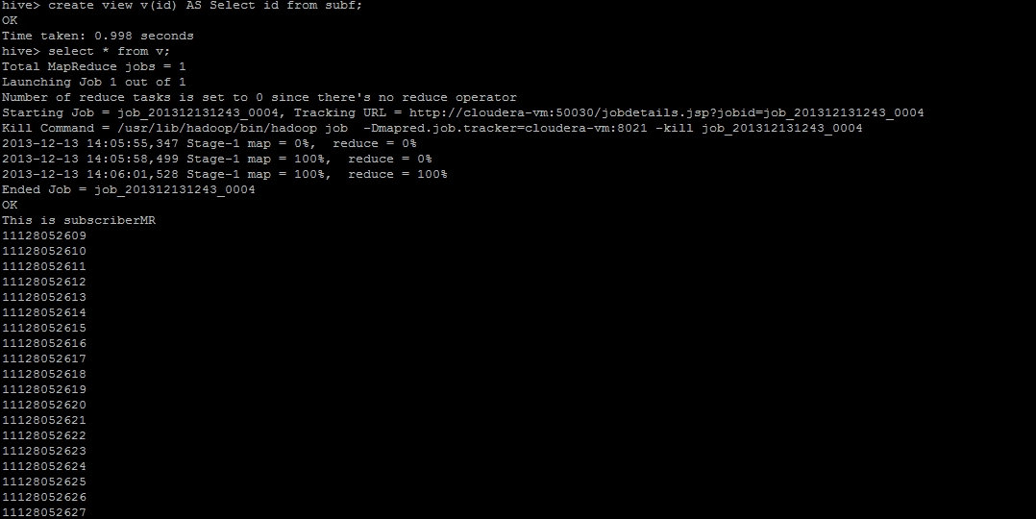
View

Slide 45
Partitioning
Partitioning a data set means dividing and splitting the data into smaller partitions using values of columns.
Hive partitions are stored in subdirectories of table directory

Slide 46
Creating custom UDFs
To implement custom UDF, need to extend org.apache.hadoop.hive.ql.exec.UDF class present in hive-exec-0.7.0-cdh3u0. This jar can be copied from /usr/lib/hive/lib of VM.
The evaluate method can be implemented accordingly

Slide 47
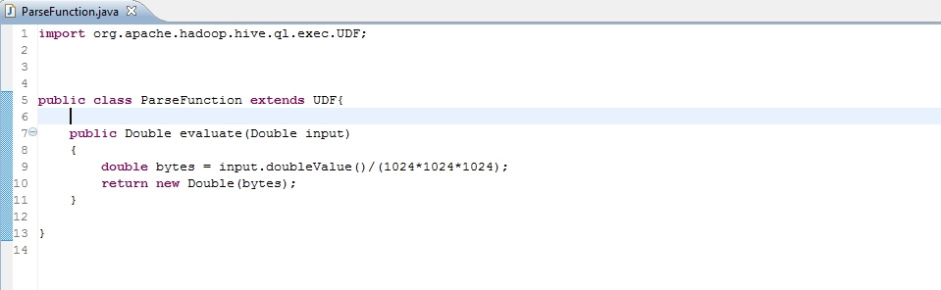
Custom UDF

Slide 48
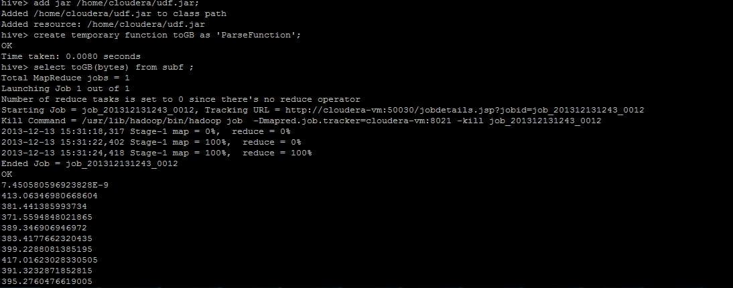
How to run UDF

Slide 49
Serde
Serde (Serializer/Deserializer) is used by Hive to control how lines are read and written to from files
When used as serializer (i.e insert) table’s serde will serialize hive’s internal representation of row of data into bytes written to output file
When used as deserializer (i.e querying the data), serde will deserialize a row of data from bytes in file to objects

Slide 50
Hive serde
SerDeName | Java Package | Description
LazySimpleSerDe | org.apache.hadoop.hive.serde2.lazy | The default serde. Delimited textual format
LazyBinarySerDe | org.apache.hadoop.hive.serde2.lazybinary | A more efficient version of LazySimpleSerde Binary format with lazy field access
BinarySortableSerDe | org.apache.hadoop.hive.serde2. binary sortable | Optimized for storing at expense of compactness
ColumnarSerDe | org.apache.hadoop.hive.serde2. columnar | For column based storage with RCFile
RegexSerDe | org.apache.hadoop.hive.contrib.serde2 | For textual data where columns are specified by regular expression

Slide 51
Storage format
2 dimensions that control data storage in hive: Row Format and File Format
Row format dictates how rows, and fields in a row, are stored
Row format is defined by Serde (serializer/Deserializer)

Slide 52
Default storage format
Default format is delimited text, with a row per line.
Rows in a table are delimited by newline character.
Hive uses LazySimpleSerde for this format

Slide 53
Binary storage format RCFile and sequencefile
Using case study 1 of MR the output file generated by Subscriber Mapper and Reducer was sequence file.(key/value pairs)
Sequence files are row oriented
RCFiles, row columnar file. Similar to sequence file but data is stored in columnar fashion.

Slide 54
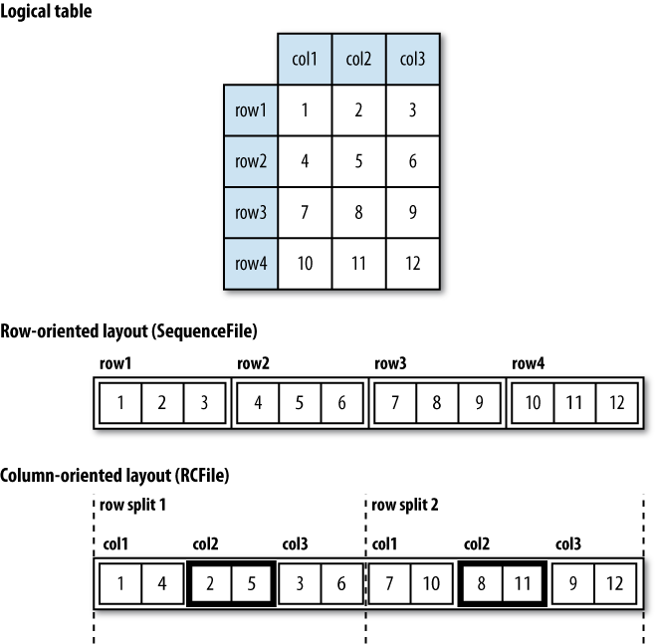

Slide 55
Case study 2
The output of the SubscriberMapper and SubscriberReducer was sequence file
The create command should be Create external table SubscribersUnsorted(id String, bytes Double) ROW FORMAT DELIMITED FIELDS TERMINATED BY '\t' STORED AS SEQUENCEFILE location '/output';

Slide 56
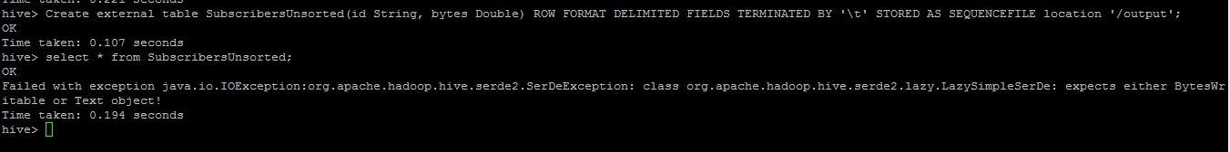
Sequence file

Slide 57
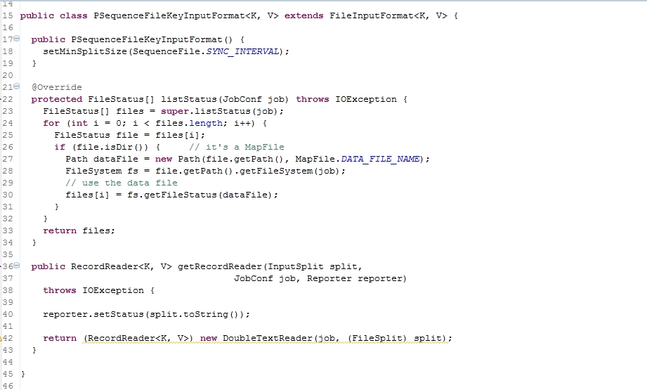

Slide 58
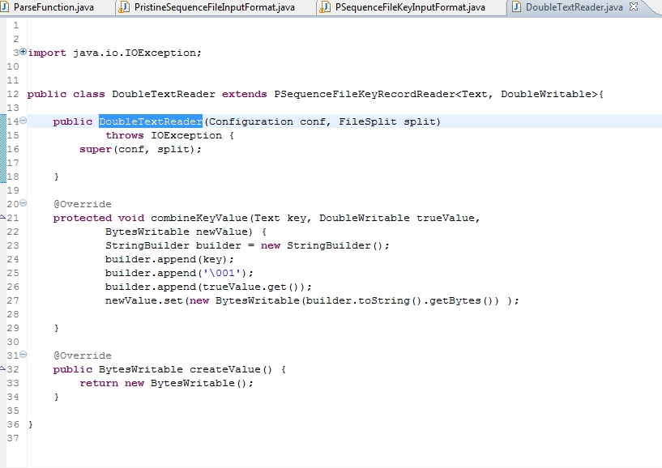

Slide 59
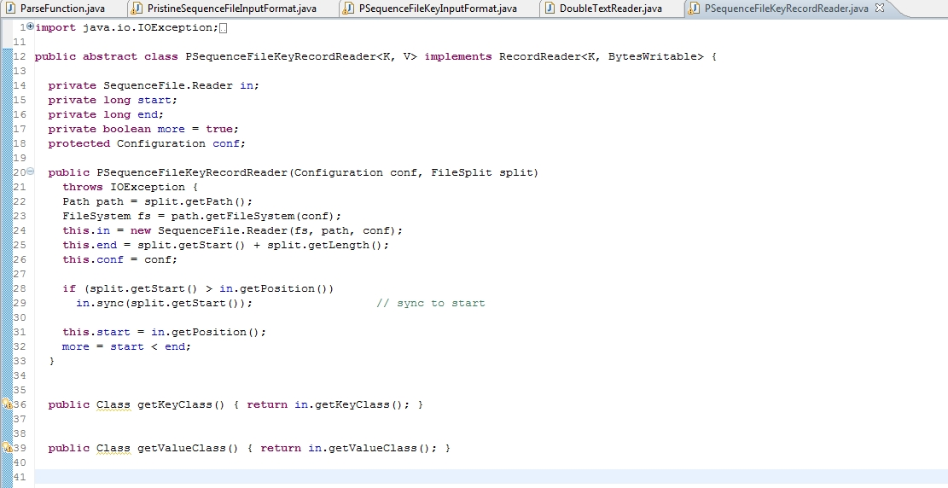

Slide 60
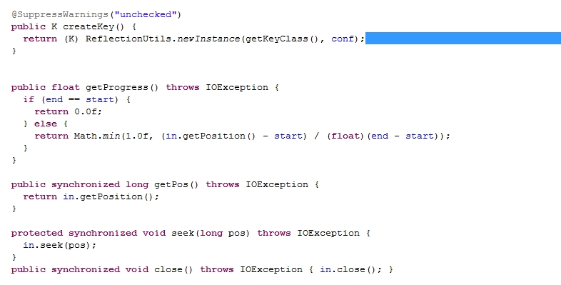

Slide 61
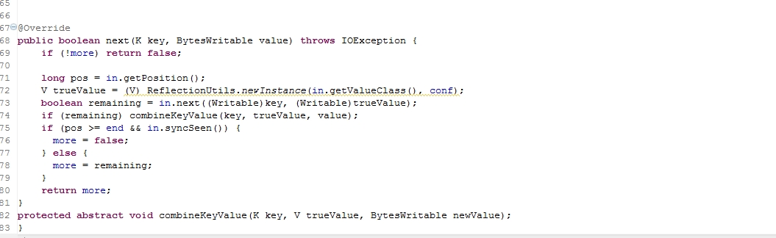

Slide 62
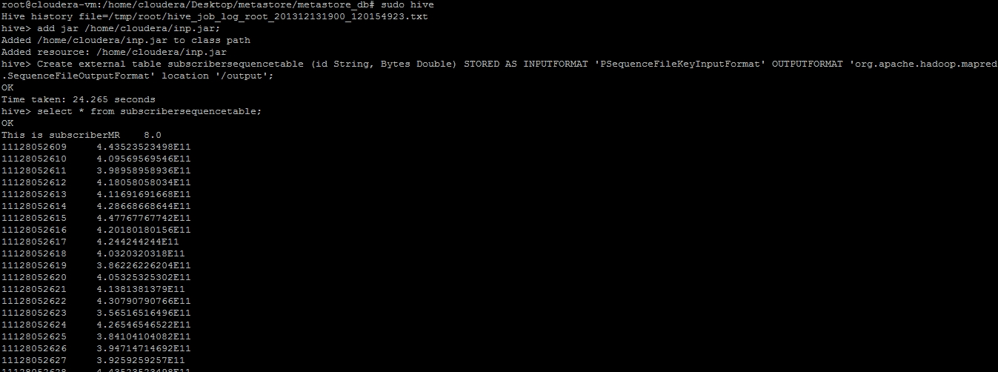

Slide 63
Exercise
Put given csvInput file in exercise folder of hdfs. This file is sampleinput that gives the username and the site he accessed
Write MR job to calculate which user visited how many sites
Write MR job to calculate how many users visited the sites given in the file
Write HIVE QL to calculate the above two counts
Write hive QL to find out all the unique usernames in the table

Slide 64
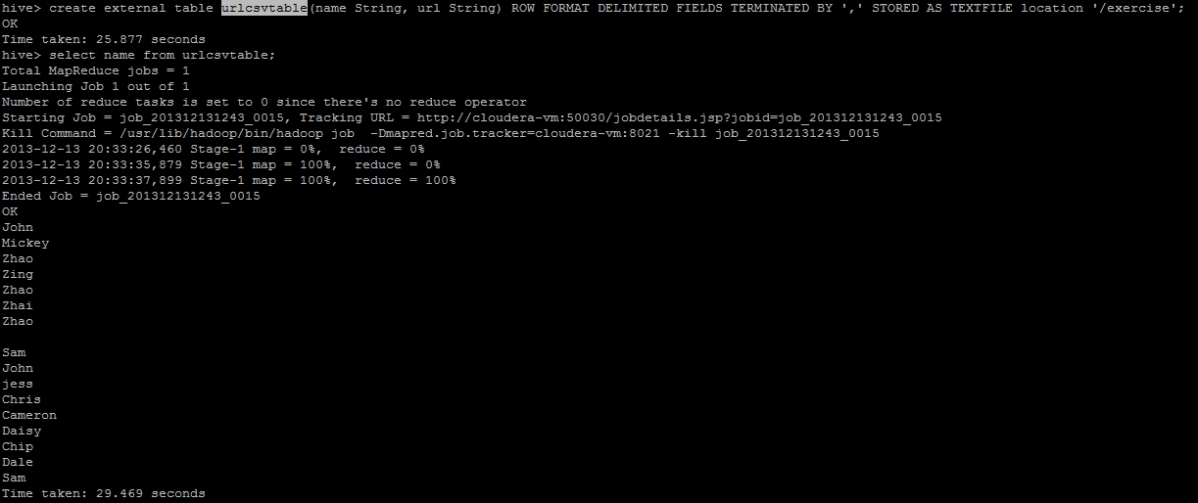

Slide 65
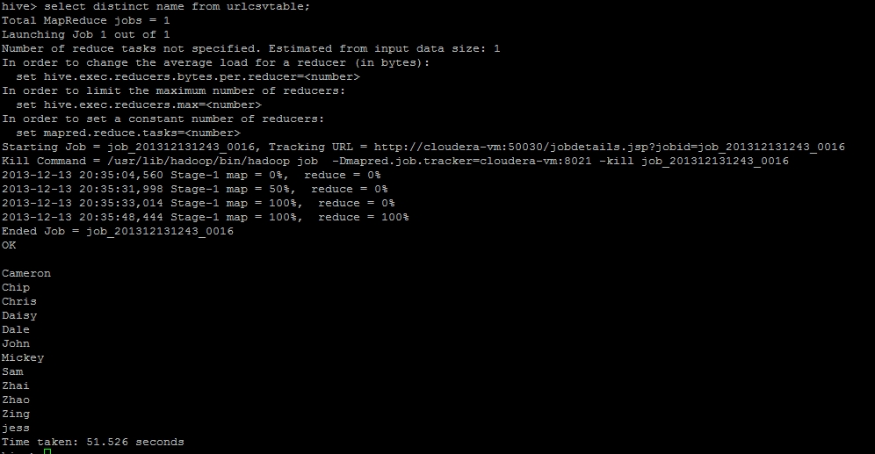

Slide 66
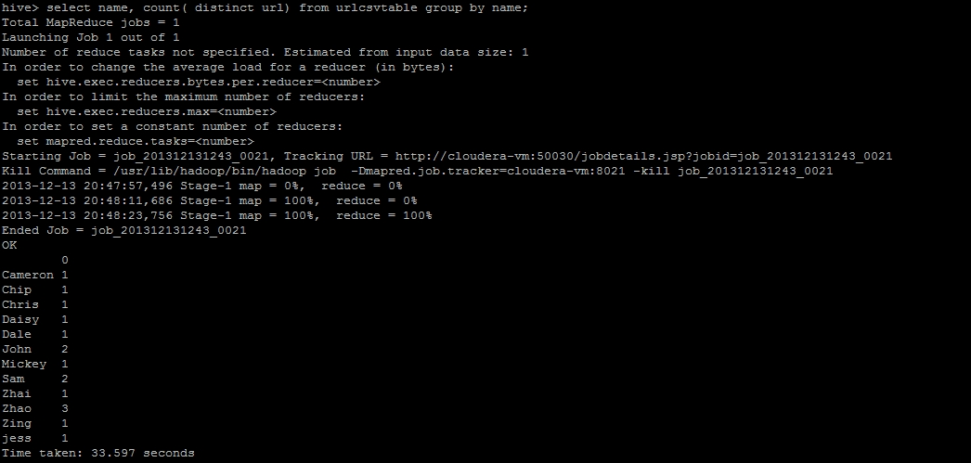

Slide 67
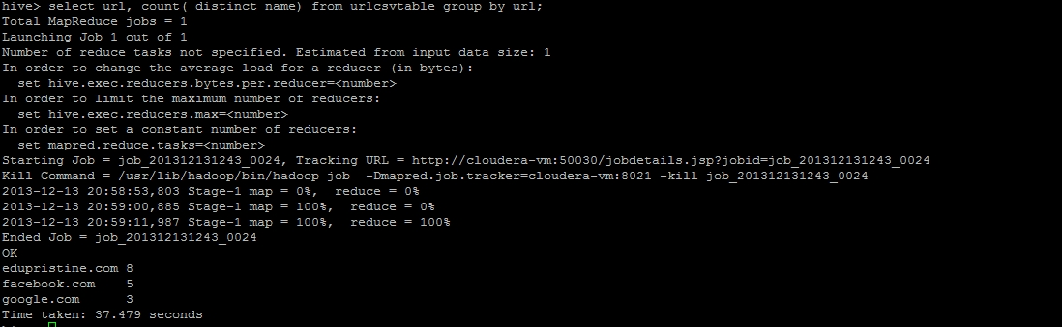

Slide 68
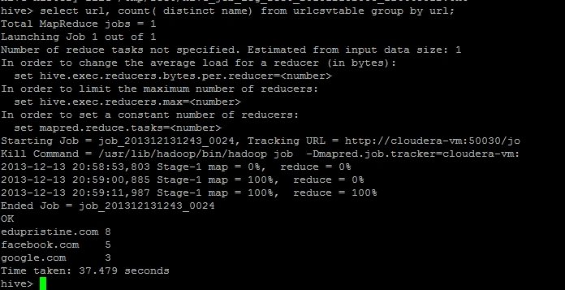

Slide 69
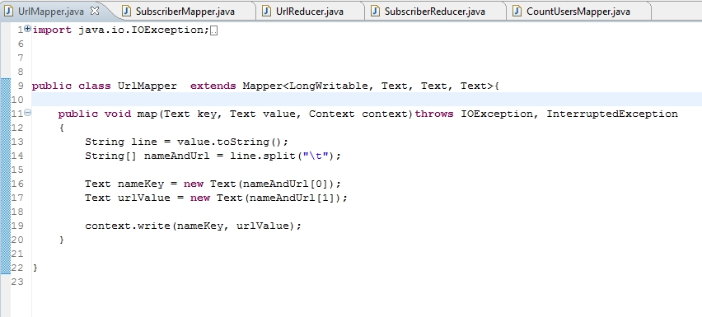

Slide 70
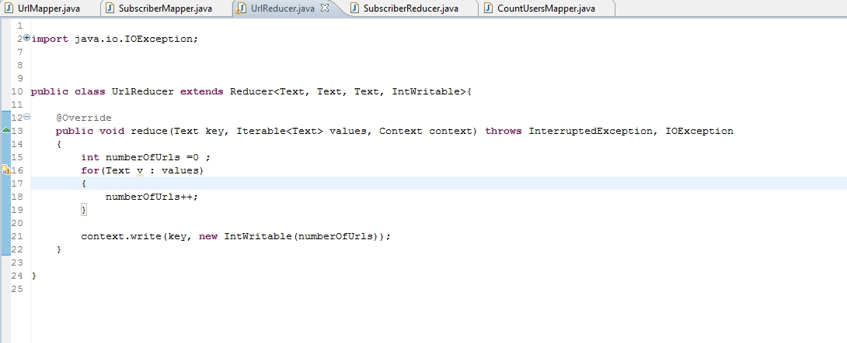

Slide 71
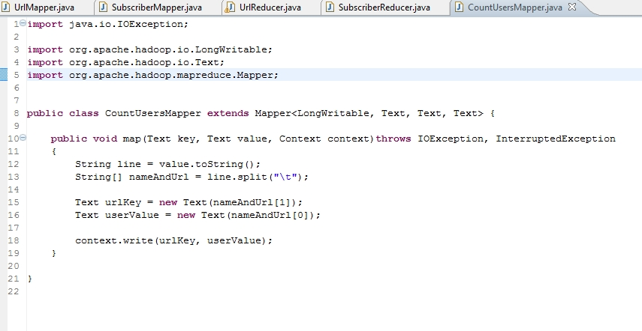

Slide 72
Performance Tuning

Slide 73
TOOLS
To check how hive translates hivequeries to MR jobs EXPLAIN command can be used. The hive optimization can be done by checking where all map reduce jobs stages can be optimized.
With EXPLAIN the output will be
ABSTRACT SYNTAX TREE: (TOK_QUERY
(TOK_FROM (TOK_TABREF (TOK_TABNAME onecol))) (TOK_INSERT (TOK_DESTINATION (TOK_DIR TOK_TMP_FILE)) (TOK_SELECT
(TOK_SELEXPR (TOK_FUNCTION sum (TOK_TABLE_OR_COL number))))))
The stages(merge, MapReduce job)can be inferred from this output.

Slide 74
LIMIT TUNING
LIMIT clause: executes entire query then only returns the cropped results.
To avoid executing entire query following property can be used
<property> <name>hive.limit.optimize.enable</name> <value>true</value> <description>Whether to enable to optimization to try a smaller subset of data for simple LIMIT first.</description>
</property>
NOTE: This will yield correct results only when the query has map steps. If the query also has reduce step the results can be incorrect. (Because the hive will not process all the data and will limit the records right at the starting of execution of jobs)

Slide 75
Join Optimization
When joining 3 or more tables, if every ON clause uses the same join key, single MR job will be used.
Hive assumes that the last table in the query is the largest. It will buffer other tables and stream the last table, while performing the joins. Therefore the largest table should be kept last in the query

Slide 76
PARALLEL EXECUTION
Since hive queries are executed in stages, by default it executes one stage at a time.
Some times jobs consist of stages that are not dependent on each other and can be executed in parallel, allowing overall job to complete quickly. For this following property can be set
<property> <name>hive.exec.parallel</name> <value>true</value> <description>Whether to execute jobs in parallel</description>
</property>

Slide 77
JVM REUSE
When there are small number of files and lots of tasks most with short execution times.
Default configuration of hadoop will typically launch map/reduce tasks in forked JVM. JVM startup has it’s own overhead of starting. This can become bottleneck if there are thousands of tasks. To allow reuse of existing JVMs to a limit following property can be used
<property>
<name>mapred.job.reuse.jvm.num.tasks</name>
<value>10</value>
<description>How many tasks to run per jvm. If set to -1, there is no limit. </description>
</property>

Slide 78
Limitations of HIVE

Slide 79
Limitations of Hive
Hive can’t be used for the problems that require response in milliseconds. Since hive launces MR job for most of the queries this staging takes time
HIVE Queries are structural, you have to clearly specify what needs to be performed in what order using subqueries. This can become tedious if there are complex number of steps to be executed. For this Pig can be used which is more procedural like language, where the sequence of steps to be performed can be mentioned with individual statements
Once data is inserted into table, data can’t be updated
Splitting data: Data at various stages is merged and combined by SQL and in the end a single result is obtained. Hence splitting is not possible. Pig on the other hand can be used to save the result at different stages.

